Slide 1
CUSTOMER CHURN PREDICTION
BY: VINAYAK GUPTA
BATCH: MIP-ML-08

Slide 2
agenda
PROJECT OVERVIEW 1-7
EDA 8-15
DATA PREPROCESSING 16-19
MODEL DEVELOPMENT & EVALUATION 20-26
PREDICTING CHURN & RECOMMENDATIONS 27-33

Slide 3
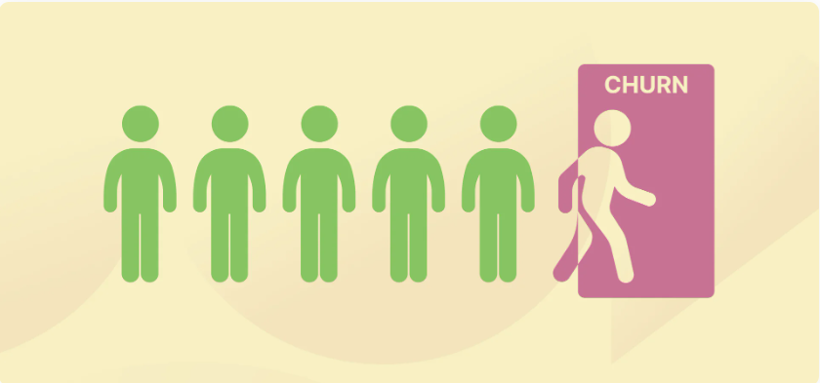
Introduction Customer Churn prediction means knowing which customers are likely to leave or unsubscribe from your service. For many companies, this is an important prediction. This is because acquiring new customers often costs more than retaining existing ones. Once you’ve identified customers at risk of churn, you need to know exactly what marketing efforts you should make with each customer to maximize their likelihood of staying. Customers have different behaviors and preferences, and reasons for cancelling their subscriptions. Therefore, it is important to actively communicate with each of them to keep them on your customer list. You need to know which marketing activities are most effective for individual customers and when they are most effective.
Impact of customer churn on businesses
A company with a high churn rate loses many subscribers, resulting in lower growth rates and a greater impact on sales and profits. Companies with low churn rates can retain customers.
1

Slide 4
Dataset Overview
customerID : CustomerID
Gender : Customer’s gender
SeniorCitizen: Whether the customer is a senior citizen or not
Partner : Whether the customer has a partner
Dependents : Whether the customer has dependents
Tenure : No. of months the customer has stayed with the company
PhoneService : Whether the customer has multiple phone lines
MultipleLines : Whether the customer has multiple phone lines
InternetService : Type of internet service
OnlineSecurity : Whether the customer has online security
OnlineBackup : Whether the customer has online backup

Slide 5
Dataset Overview
DeviceProtection : Whether the customer has device protection
TechSupport : Whether the customer has tech support
StreamingTV : Whether the customer has tech support
StreamingMovies : Whether the customer streams movies
Contract : Type of contract
PaperlessBilling : Whether the customer uses paperless billing
PaymentMethod : Mode of payment
MonthlyCharges : Charges per month
TotalCharges : Total charges
Churn : Target variable, indicating whether the customer churned

Slide 6
Why is Analyzing Customer Churn Prediction Important?
Customer churn is important because it costs more to acquire new customers than to sell to existing customers. This is the metric that determines the success or failure of a business. Successful customer retention increases the customer’s average lifetime value, making all future sales more valuable and improving unit margins.
The way to maximize a company’s resources is often by increasing revenue from recurring subscriptions and trusted repeat business rather than investing in acquiring new customers. Retaining loyal customers for years makes it much easier to grow and weather financial hardship than spending money to acquire new customers to replace those who have left.

Slide 7

Reviewing the Dataset
First, let’s load the dataframe into Python with the pandas library and take a look at its head. I’ve renamed the file to “customer_churn.csv”, and it is the name I will be using below:

Slide 8
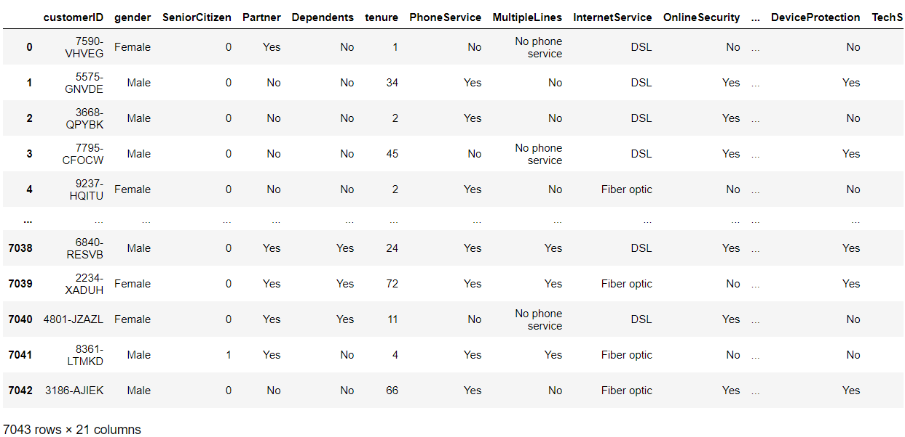
Provided dataset
We can observe that there are 7043 rows and 21 attributes in the provided dataset.
Attributes:
customerID
Gender
SeniorCitizen
And many more

Slide 9
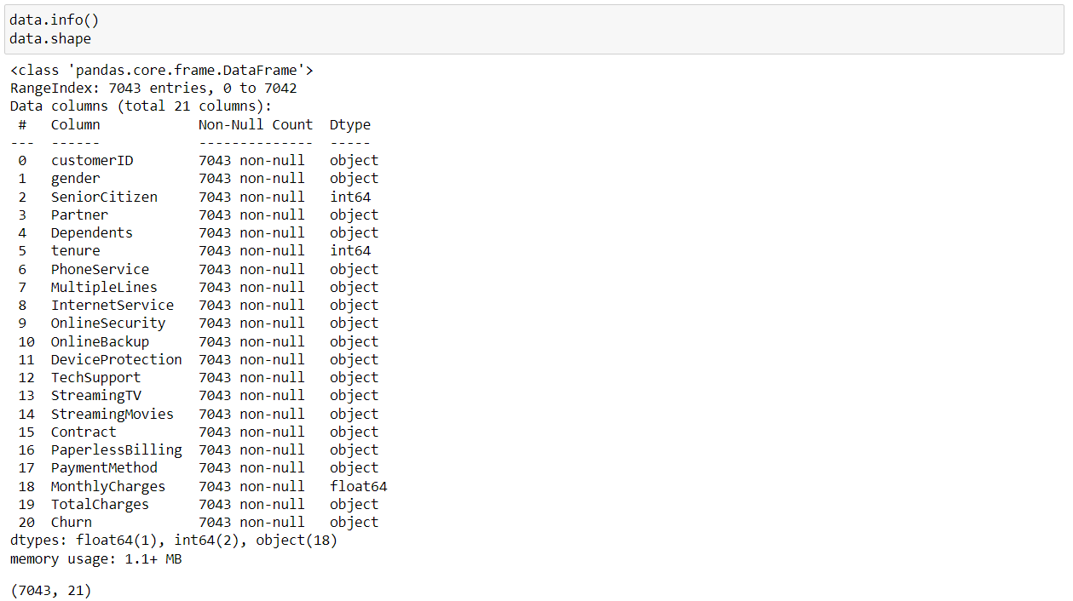
Dataset Information
Each user is identified through a unique customer ID. There are 19 independent variables used to predict the target feature – customer churn. In this dataset, customer churn is defined as users who have left within the last month.

Slide 10
EDA
Now, let’s perform some exploratory data analysis to gain a better understanding of the independent variables in the dataset and their relationship with customer churn.

Slide 11
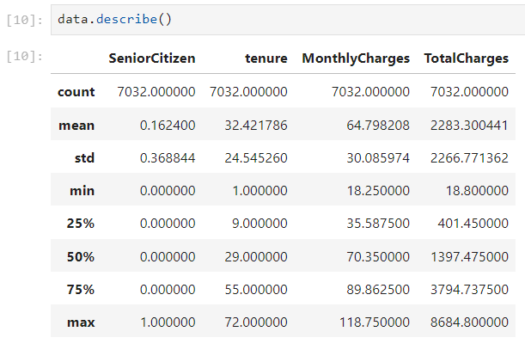
Dataset Description
We can observe the statistical measures like mean, standard deviation, maximum and minimum values along with various quartile ranges of our dataset.

Slide 12
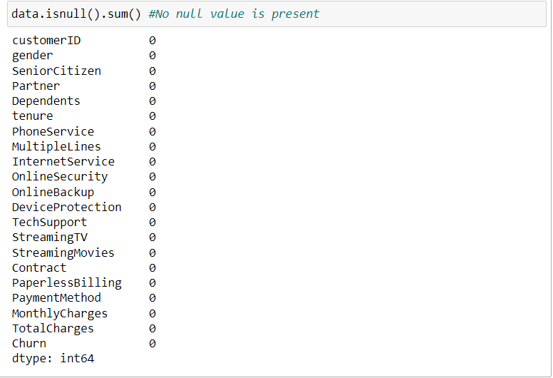
Null count of attributes
Here we can see the null count of each attribute is zero, as in TotalCharges there was 11 null values, which has been removed.

Slide 13
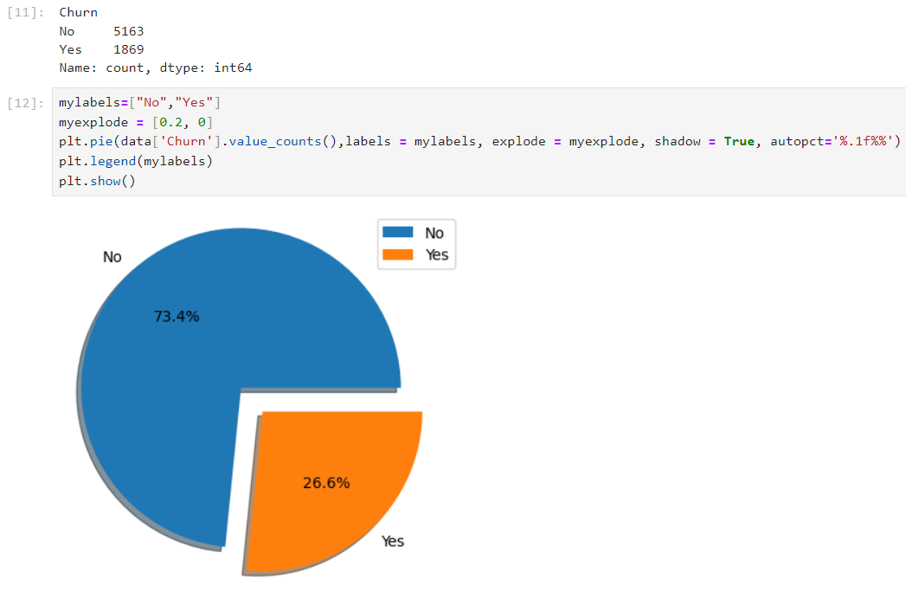
Data Visualization
Total Customer Churn visualization using pie chart.
We can observe that 26.6% of customer churns out and only 73.4% of the customer remains loyal and stays with the company/brand.
Further, we’ll see insights on the basis of few attributes.

Slide 14
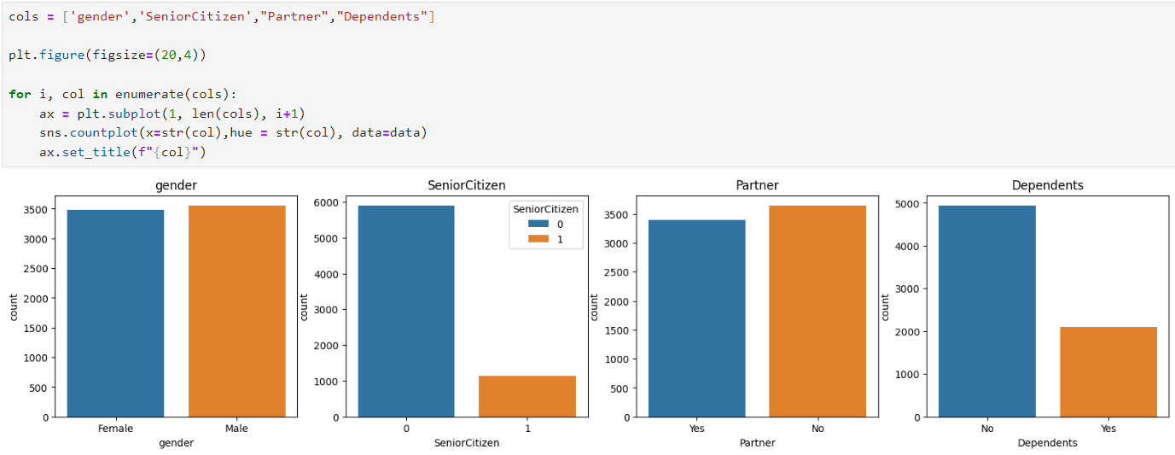
Analyzing the demographic data points
Most customers in the dataset are younger individuals without a dependent. There is an equal distribution of user gender and marital status.

Slide 15
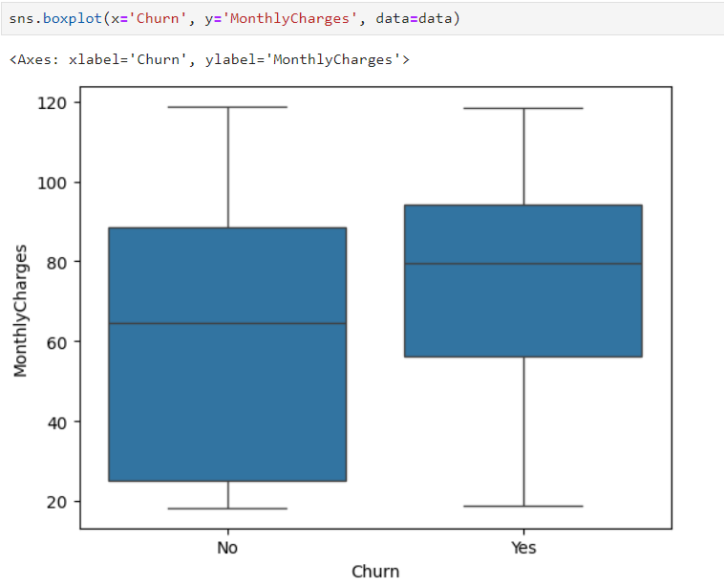
Relationship between cost and customer churn
Assumption: Users tend to unsubscribe to their mobile service provider and switch to a different brand if they find the monthly subscription cost too high.
The assumption above is true. Customers who churned have a higher median monthly charge than customers who renewed their subscription.

Slide 16
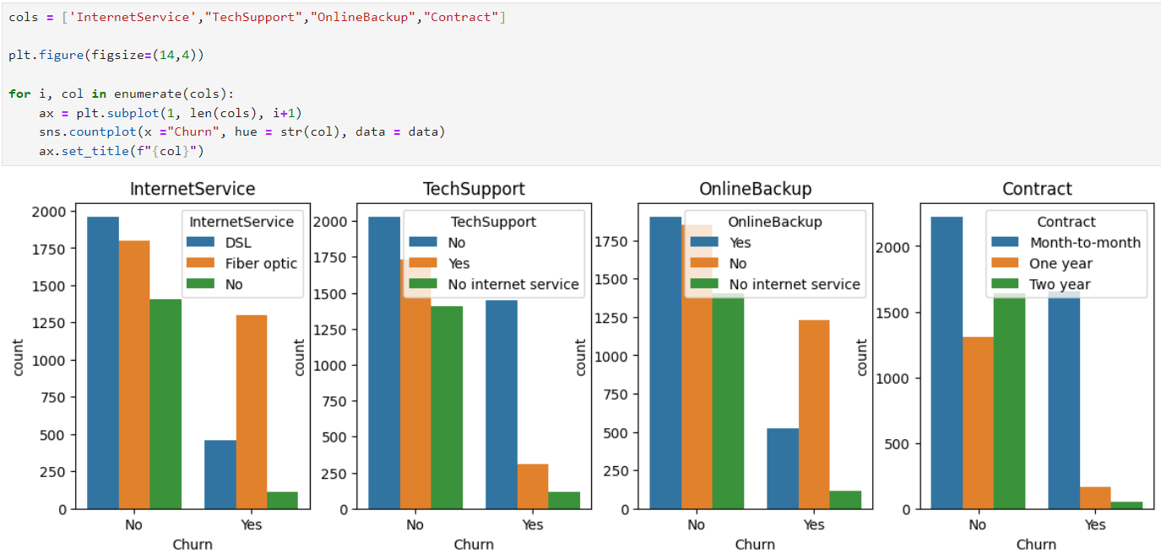
Relationship between customer churn and a few other categorical variables captured in the dataset

Slide 17
Let’s look into each attribute
InternetService: It is clear from the visual above that customers who use fiber optic Internet churn more often than other users. This might be because fiber Internet is a more expensive service, or this provider doesn’t have good coverage.
TechSupport: Many users who churned did not sign up for tech support. This might mean that these customers did not receive any guidance on fixing technical issues and decided to stop using the service.
OnlineBackup: Many customers who had churned did not sign up for an online backup service for data storage.
Contract: Users who churned were almost always on a monthly contract. This makes sense, since these customers pay for the service on a monthly basis and can easily cancel their subscription before the next payment cycle.
Even without building a fancy machine learning model, a simple data-driven analysis like this can help organizations understand why they are losing customers and what they can do about it.
For instance, if the company realizes that most of their users who churn have not signed up for tech support, they can include this as a complimentary service in some of their future product offerings to prevent other customers from leaving.

Slide 18
Data Preprocessing
Now that we have a better understanding of our dataset, let’s perform some data preparation before creating the machine learning model. There are three steps to this process:
Cleaning the dataset
Encoding Categorical Variables
Feature scaling or normalizing

Slide 19
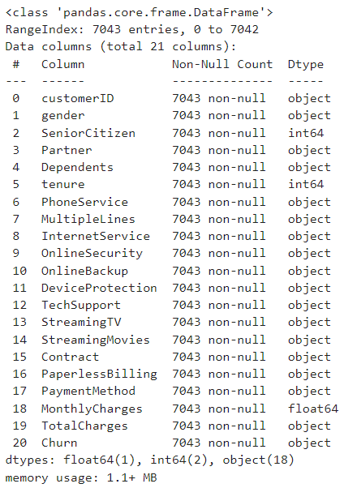
Cleaning the dataset
Notice that the variable “TotalCharges” has the data type “object,” when it should be a numeric column. Let’s convert this column into a numeric one:

Slide 20
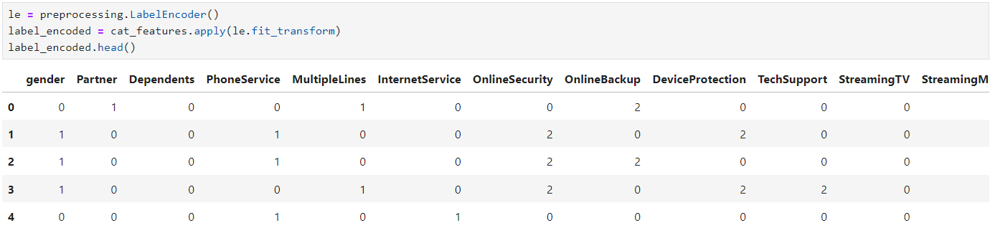
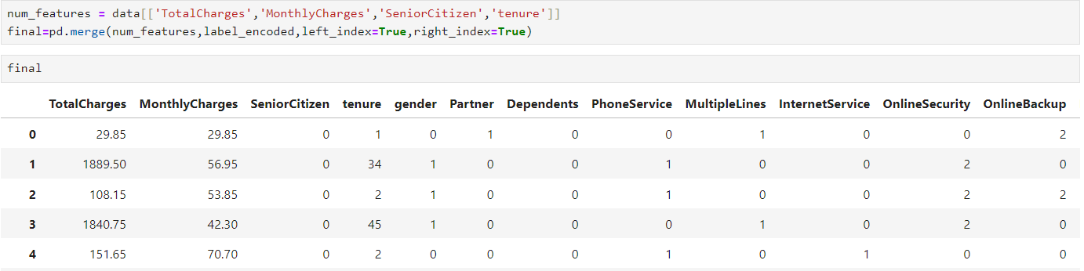
Label Encoding

Slide 21
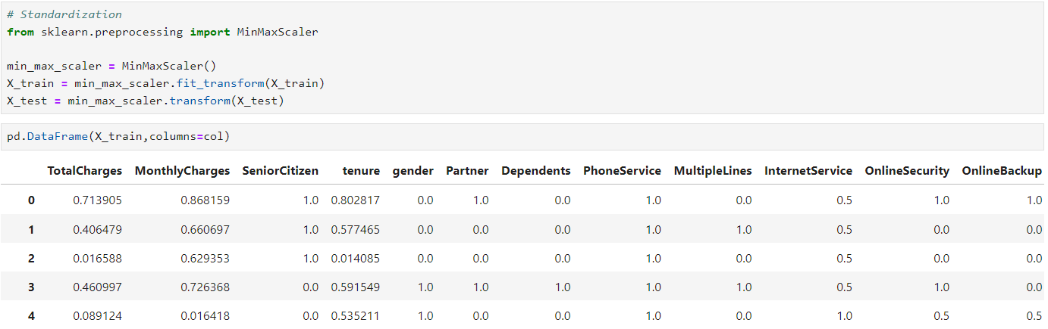
Feature Scaling

Slide 22
Machine Learning Model Development & Evaluation
Train various machine learning models for classification

Slide 23
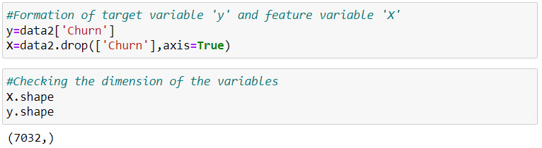
Creation of variables

Slide 24
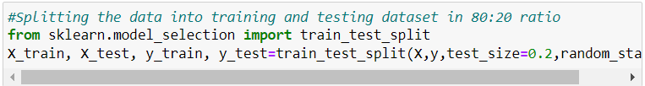
Data Splitting
Data is split into training and testing data in 80:20 ratio respectively.

Slide 25
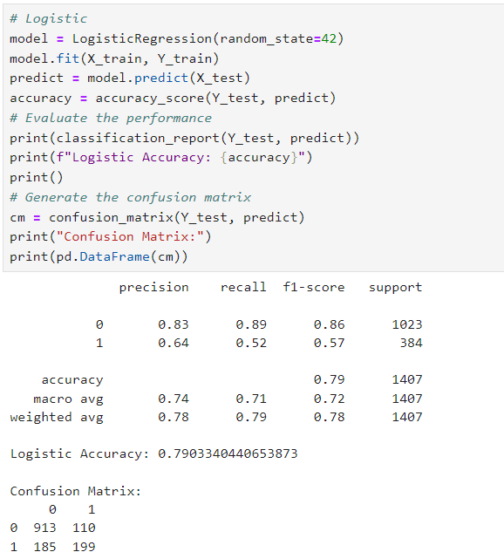
Logistic Regression Model
Using Logistic Regression, we get the accuracy of 79.03%.

Slide 26
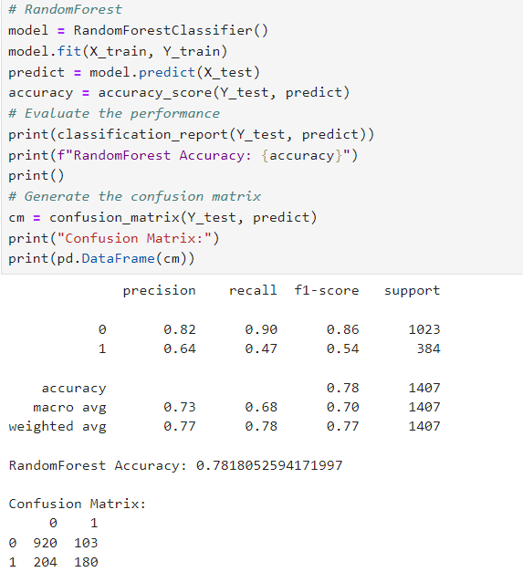
Random Forest Model
Using Random forest, we get the accuracy of 78.18%.

Slide 27
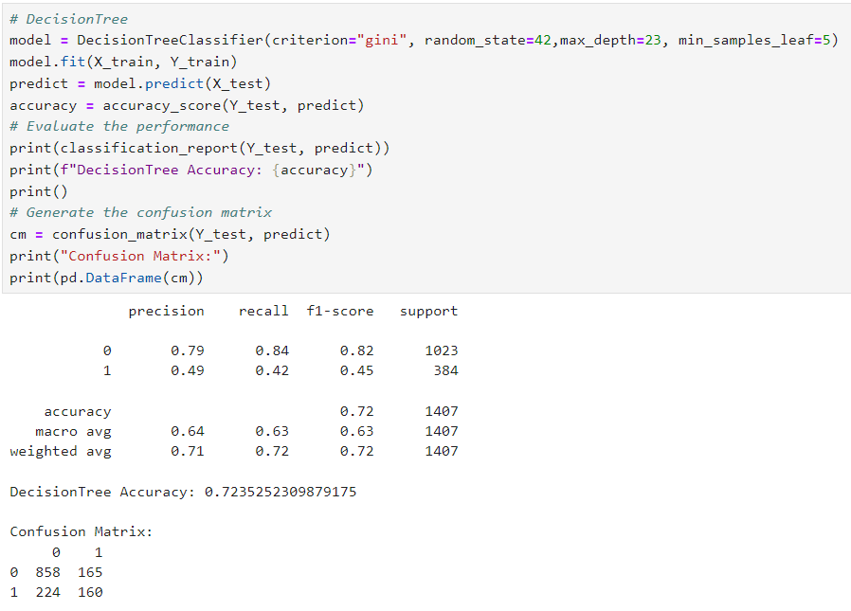
Decision Tree Model
Using Decision-Tree Classifier, we get the accuracy of 72.35%.

Slide 28
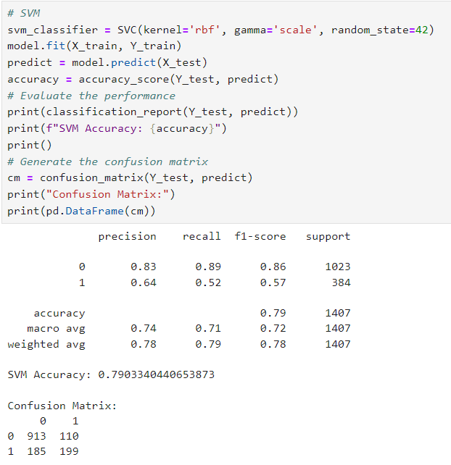
SVM Model
Using SVM, we get the accuracy of 79.03%.

Slide 29
Model Evaluation
Assessing the performance of our models and comparing each

Slide 30
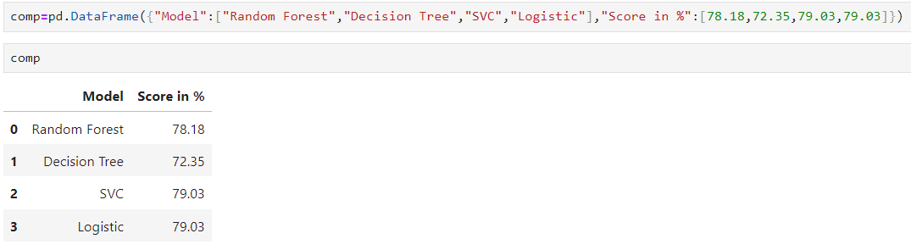
Model Evaluation & Comparison

Slide 31
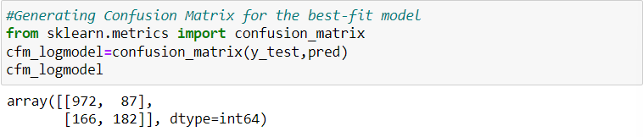
Confusion Matrix of Logistic Regression
29

Slide 32
Confusion Matrix of Logistic Regression

Slide 33
Predicting the Churn Probability
Let us see the churn probability of each customer

Slide 34
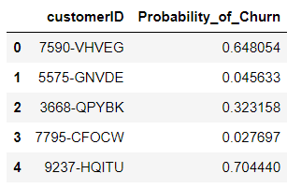
Predicting Churn
Dataframe of Customer Churn Probability

Slide 35
Recommendation
Give your loyal customers reasons to stick around with your brand. Loyal customers not only buy regularly from you but also suggest their family, friends, and business associates to you. Offer loyalty or reward points, birthday/anniversary discounts reward points that can be redeemed, etc.
Customer is the king and rightly said. For a business, it is extremely important to know if its customers are satisfied with its products or services. The easiest way to know that takes a quick customer satisfaction feedback. Ask your customers the right questions to get the right feedback, which will ultimately help you make informed decisions/ timely changes (if needed) thereby reducing the number of dissatisfied customers.
Offer them long-term discounts. A long-term discount or contract should benefit both, the business and the customer.

Slide 36
Thank you
VINAYAK GUPTA
viniatul18@gmail.com
MIP-ML-08
MENTORNESS

